Slide 1
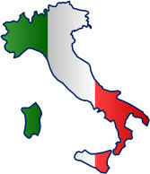
Italy
Conor Larkin
4th Class

Slide 2
Where is Italy located?
Italy is a Mediterranean country located in southern Europe.
It is bordered by the Adriatic Sea on the east coast, the Tyrrhenian Sea on the west or Mediterranean coast, and the Ionian Sea to the south.
In the north, Italy is bordered by the countries of France, Switzerland, Austria, and Slovenia.

Slide 3
Italian History
Rome was founded in 753BC.
The Roman Empire broke down in 395AD, after this there were many separate kingdom and city states.
Italy became one nation in 1861. The ‘kingdom of Italy’ lasted from 1861-1946.
After WW2, the Italian Republic was formed in 1946.

Slide 4
Interesting Facts
It's proper name Repubblica Italiana (Italian Republic), Nickname: “Bel Paese” which means beautiful country.
The capital of Italy is Rome. It was founded in 753 BC
The flag of Italy, often referred to in Italian as il Tricolore; is a tricolour and has three equally sized vertical stripes of green, white and red, with the green at the post side. The current flag has been in use since 18 June 1946.
Italy is famous for it’s art, history, food and cars.
60.36 million people live in Italy.

Slide 5
Interesting Facts
Italy’s largest island is Sicily. This island is also the largest island in the Mediterranean Sea.
The highest mountain peak in Italy is Monte Bianco, and it is better known as Mont Blanc, which is 4 807 m or 15 776 ft high.
There are 1,500 lakes in Italy.
There are 28,138 mountains in Italy.

Slide 6
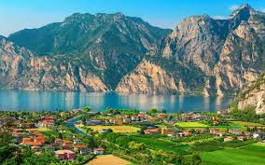
Italian Lakes
Lake Garda is Italy’s largest lake approximately 370 km in size. It stretches over 3 Italian provinces is famous for historical battles as it has been inhabited since 2000BC.
Lake Como is one of the deepest lakes in Europe, over 400 metres deep, it has may old and famous villas on its shores.

Slide 7
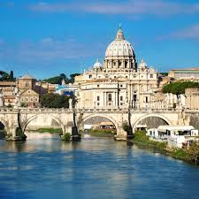
The Vatican City
The Vatican city is the smallest country in the world.
It is 100 acres in size and is located in the heart of Rome.
It is the home of the Pope. There is a secret passageway which runs from the Vatican to a fortress and was used to take Popes to safety during battles.

Slide 8
Thank you for reading my project on Italy.

