Slide 1
The Hill of Tara
By Conor Larkin 4th Class

Slide 2
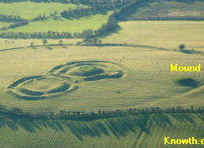
Location:
The Hill of Tara in Co. Meath is best known as the seat of the Highs Kings of Ireland but it has been an important historical site since the discovery of a late stone age passage tomb in 1995.
The Hill of Tara was both a political and religious centre in the early centuries after Christ. Tara was believed to be a dwelling place of the Gods and an entrance to the eternal world of joy.
Legend has it that on his mission to Ireland, St. Patrick first travelled to Tara in order to challenge the ancient religion at its most powerful site. The High Kings forbade Patrick to light a Paschal fire at Tara, so in defiance, he lit it on the Hill of Slane in 433 AD.

Slide 3
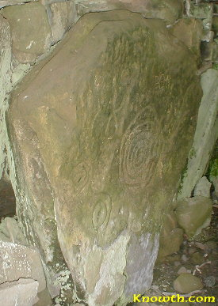
Mound of the Hostages
The megalithic passage tomb called the Mound of the Hostages is the oldest monument on the Hill of Tara dating back to between 2,500 BC and 3,000 BC. The passage was divided into three compartments each containing cremated remains. Evidence of at least 200 individual cremations were found, so the passage tomb description is appropriate.
A decorated stone can be viewed from the entrance gate. The engravings may represent the sun, moon or stars as religious symbols or maybe the stone was used as a prehistoric calendar.
The hills at Loughcrew can be seen to the west from the top of the mound.

Slide 4
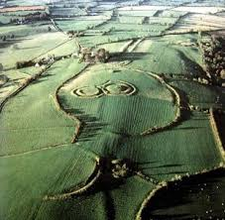
Seat of the High King
Long after the megalithic mound was constructed Tara became the seat of the High Kings of Ireland.
The most famous of these was Cormac Mac Airt who reigned in the third century AD. One of the ring forts within the large hill fort known as the Royal Enclosure is known as Cormac's House.
The other ring fort known as the King's Seat may actually be constructed around a prehistoric tomb.

Slide 5
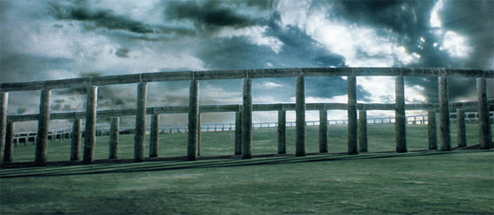
Irelands Stonehenge
Ireland's Stonehenge, a 4,500-year-old structure at the Hill of Tara , has been re-created by archaeologists and computer-graphics experts. They have built a representation of a huge, wooden monument that appears to have been used for crowning ceremonies and pagan burials of Ireland’s high kings.
Remains of the structure were discovered by soil x-rays of the hill. The model was created using information gathered from studying a ditch, six metres wide and three deep, cut into the bedrock of the hill and enclosing the Mound of Hostages.
Scientists believe that the hill was once surrounded by a “wooden version of Stonehenge” that would have been 250 metres in diameter, similar in size to Croke Park.

Slide 6
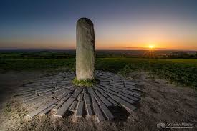
The Lia Fail.
The standing stone known as the Lia Fáil, though erected on the King's Seat around 1824, may once have stood in front of the entrance to the passage tomb (Mound of the Hostages) and belong to a tradition of erecting standing stones around or in passage tombs.
The Lia Fáil, or Stone of Destiny, which stands about one metre in height is considered by some to have been a fertility symbol.
According to legend on the inauguration or crowning of a worthy High King, the stone would roar its approval.

Slide 7
Thank you for reading my project.
Conor.

