Slide 1
Bees
Conor Larkin
4th class

Slide 2
Why I decided to do a project on bees:
I decided to do a project on bees because they are an endangered species and I love watching them work.
3 species of bees have become extinct in Ireland in the last 80 years.
The main reasons for them becoming extinct are climate change, people using pesticides and destruction of their habitats.

Slide 3
Honey bee (Latin Name:Apis mellifera)
The Honey bee also known as the European Honey Bee or Western Honey Bee
The Honey bee is a common flying insect known for its skill in collecting nectar from flowers and making honey. Honey bees are mustard yellow and brown. They have stocky bodies that are covered with many hairs to which pollen stick to.
The honey bee's most important job is to pollinate crops.

Slide 4
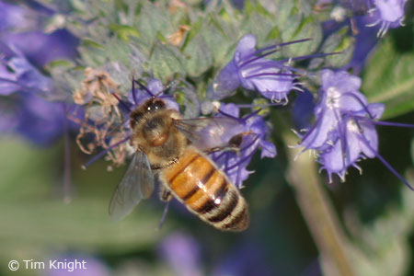
What They Eat
Honey bees gather nectar and pollen from flowering plants. They do not eat meats.

Slide 5
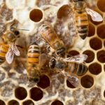
How They Live:
Honey bees live in large colonies or hives. The hive is guarded at all times by a small number of bees who fly around the hive warning others if there is a threat. The queen bee is cared for by the worker bees and the drones do little eexcpet sip honey! The queen bee, drones and worker bees all have precise jobs to do in the colony. The queen bee lays hundreds of eggs. The male drones sip honey until they are told to leave by their sisters. Worker bee are all females. They care for the queen, produce honey and pollinate plants.

Slide 6
The 3 Types Of Bees In A Hive
The queen bee runs the whole hive. She is the largest bee in the hive. She is lucky and is treated like royalty. The worker bees clean her feed her and remove her waste! She just has to lay eggs.
Worker bees: These are all female and their jobs are to search for food (pollen and nectar from flowers), build and protect the hive, clean and mix air by beating their wings. Workers are the only bees most people ever see flying around outside the hive.
Drones: These are the male bees, several hundred live in each hive during the spring and summer. But come winter, when the hive goes into survival mode, the drones are kicked out!

Slide 7
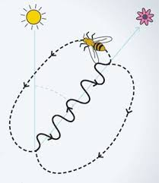
How they communicate with each other:
Honey bees are also brilliant boogiers! To share information about the best place to find food, they perform their ‘waggle dance’. When the worker returns to the hive, it moves in a figure-of-eight and waggles its body to show the direction of the food source. Isn't that cool?

Slide 8
Hope you enjoyed my project . Join me and plant some flowers for the bees!
From : Conor.

