Slide 1
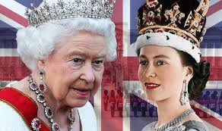
Queen Elizabeth II
Aifric Larkin
6th Class

Slide 2
Why I chose the Queen…
I chose to do a project on Queen Elizabeth II because I'm interested in the Royal family and I find the Queen very hardworking and inspiring as she is a very strong lady. She continues to work at 94 years of age, and is the longest reigning King or Queen in history since February 6th 1952.
(And she loves dogs like me!)

Slide 3
She was born on April 21st 1926 in London, her father was King George VI and her mother was Queen Elizabeth, the Queen Mother.
She had one sister named Princess Margaret who was four years younger than her.
Her full name is Elizabeth Alexandra Mary Windsor.
She became Queen at the age of 27 following the death of her father in February 1952, and her coronation was on June 2nd 1953.

Slide 4
The Queen is married to Prince Philip and their wedding took place on November 20th 1947. Her parents did not approve of Philip initially as they are third cousins, and he was not considered royalty.
Prince Philip gave up smoking for Elizabeth!
Elizabeth used ration coupons to buy her wedding dress(the government did give her an extra 200 coupons to buy the dress!)

Slide 5
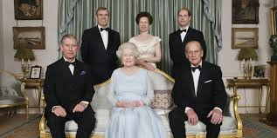
Her Family
She has 4 children, 8 grandchildren and 8 great-grandchildren.
Her son Prince Charles will succeed her as King

Slide 6
The role of the Monarchy.
In a Monarchy, a King or Queen is head of state. They work alongside the Parliament who are elected by the people of the country to make the laws of the land.
She is currently the Queen of 16 Common wealth countries including the UK, Canada, Australia, New Zealand.

Slide 7
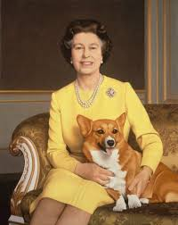
Fun facts
Her coronation was watched by 20 million people.
Her favourite dogs are corgis, and she invented a new breed of dog with her sister, Princess Margaret, by crossing a corgi with a dashaund and calling it a dorgi!

Slide 8
More fun facts …
She is the only person in the UK allowed to drive without a licence.
She owns an elephant, two giant turtles, a jaguar and a pair of sloths.
When Princess Elizabeth turned 18 in 1944, she insisted on joining the army where she trained as a truck driver and mechanic.

Slide 9
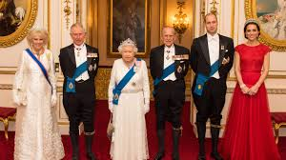
Thank you!
This is just a snippet of her life and some of the facts about her that I enjoy!!
Thanks for taking the time to read about the Queen.☺

